Slide 1
Power Conversion Board
Erin Park, Guillermo Martinez

Slide 2
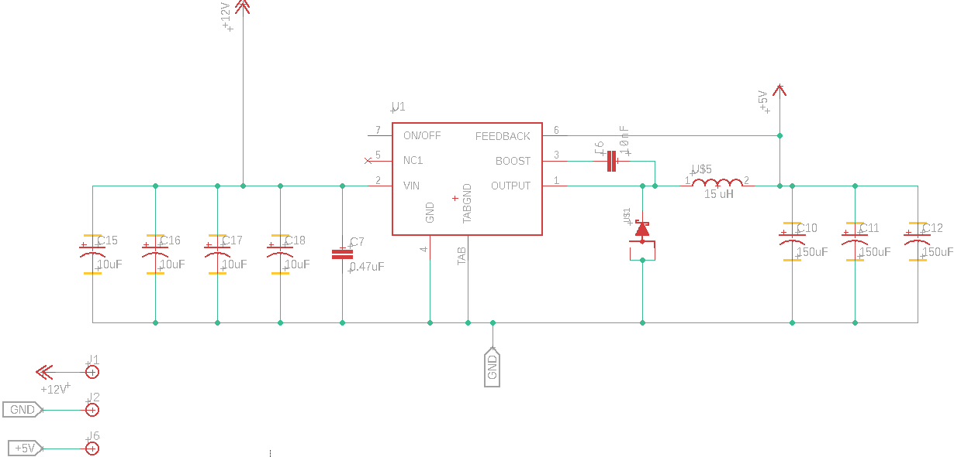
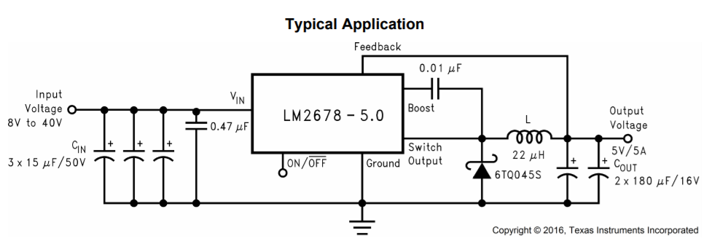
12v -> 5v Conversion
Uses LM2678 switcher to convert
Built similarly to typical application from datasheet, should work fine
Capacitor size and quantity was carried over from last year’s schematic, might be better to use the typical capacitors

Slide 3
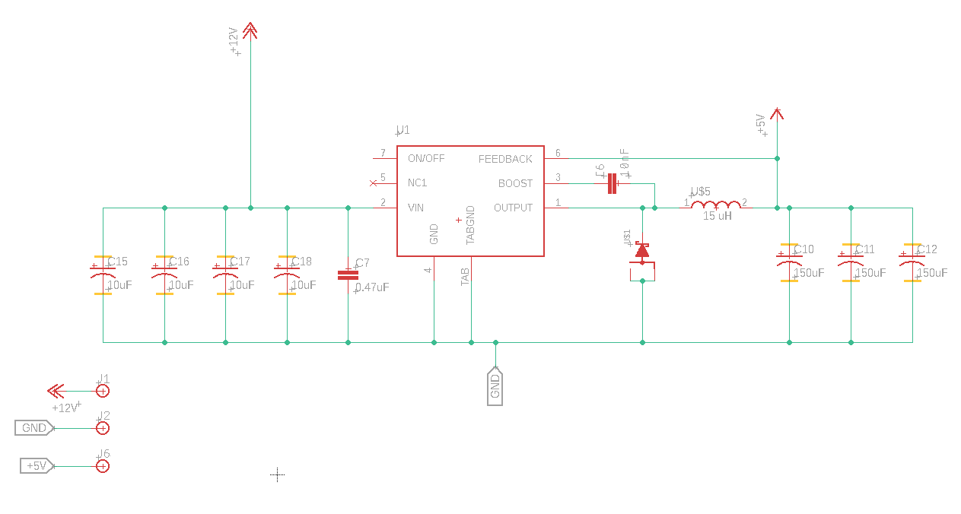

Slide 4
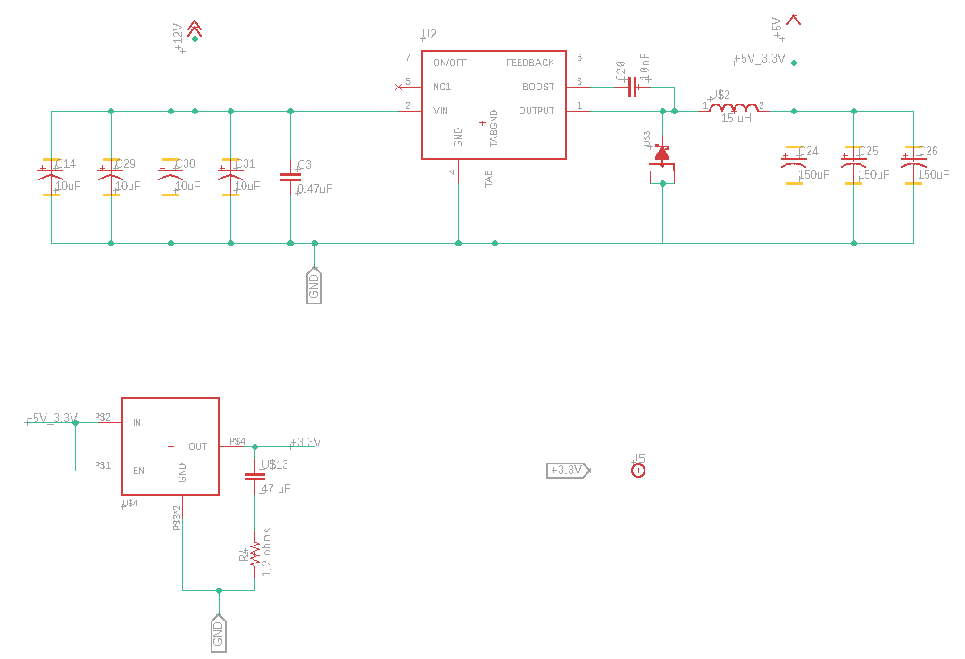
12v -> 3.3v Conversion
Top portion is exactly the same as the 12->5 conversion, separate lines are good apparently
Bottom device is a TO-263 voltage regulator to convert 5v to 3.3v
https://www.ti.com/lit/ds/symlink/tps758.pdf

Slide 6
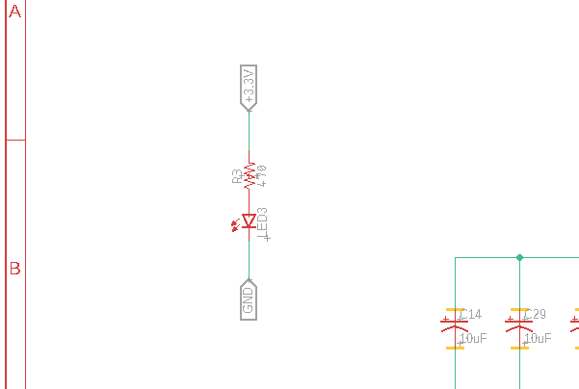
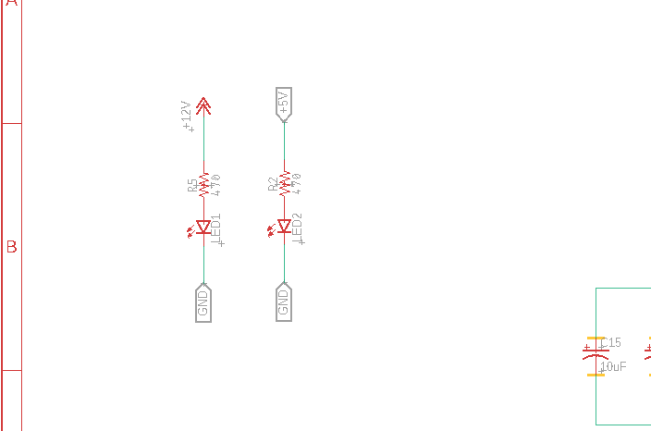
Power on LEDs
QoL feature – the LEDs will give visual feedback if the 12v, 5v, 3.3v lines are powered. Resistor values can be changed if necessary

